Slide 1

Free Python and Django workshop
for women at EuroPython, July 2015

Slide 2
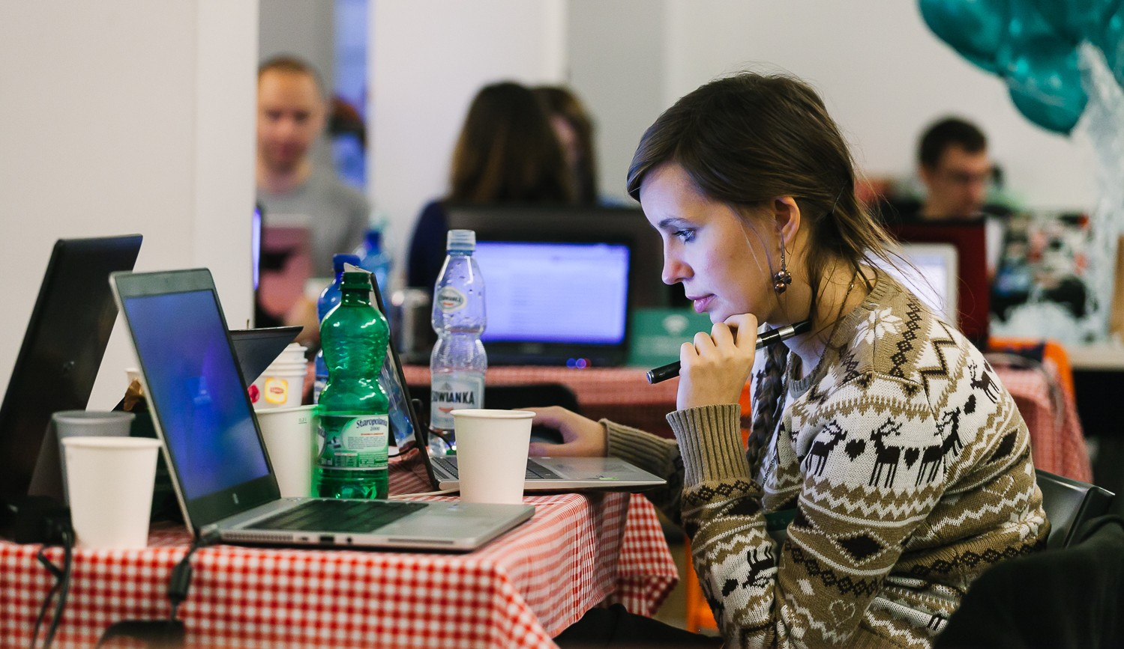
About
20th July 2015
Bilbao, Spain
Django Girls is an initiative that is aiming
to introduce 30 women who've never coded before to the world of technology and increase the diversity. On the first day of EuroPython in Bilbao, we’re going to organize an one-day workshop and invite girls from all over the world to join us and learn how to build the internet using HTML, CSS, Python and Django.

Slide 3
Target
Date & place
Supporters
30 women who never programmed before but are motivated to get into field, and who would share their experience with others
Full day, 20 July 2015 at EuroPython, one of the biggest Python conferences in Europe, hosted this year in Bilbao, Spain.
We have already partnered with 10 awesome coaches and with EuroPython who will host the workshop and our Django Girls booth at the conference.

Slide 4
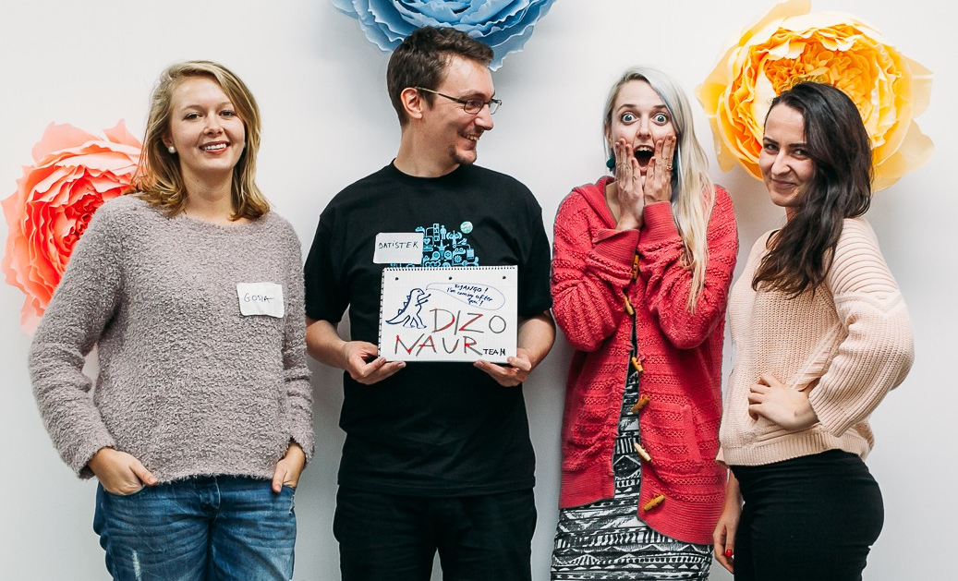
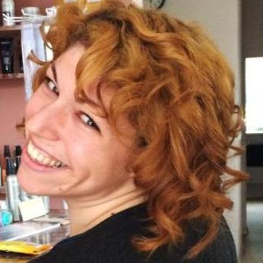
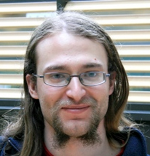
Team
Django Girls EuroPython 2015 is organized by Mikey Ariel and Petr Viktorin from Brno, Czech Republic. Mikey and Petr already co-organized the first Django Girls Brno workshop in February 2015.
Mikey and Petr work at Red Hat, Mikey as a technical writer as well as a community lead for Write the Docs EU, and Petr as a Python developer, Python meetup organizer, PyLadies CZ instructor and program developer. Both sleep very little.
@thatdocslady
@EnCuKou

Slide 5

SUPPORT US!
We’re looking for kind souls and organizations that support the goal of bringing more women into technology to help us.
With every sponsor, we can bring more and more women from all over the world to our workshop and to EuroPython to learn about programming. Your money will go towards their travel financial aid, food and supplies during the workshop, and other necessary expenses to make the workshop a welcome, fun, and friendly place for these newcomer women!
Every woman at our Django Girls workshop will receive a free ticket to EuroPython, for which EuroPython has provided us with a substantial discount. We will also be operating a Django Girls booth at the conference, where our graduates and coaches will be available to answer questions and give information to anyone who would like to learn about diversity and outreach programs.

Slide 6
SUPPORT US!
You can help us in (at least) three ways:
2000 €
1200 €
800 €
company logo on website
company logo on poster
Welcome tweet
Welcome email
5-minutes Lightning Talk
Company logo on website
Company logo on poster
Welcome tweet
Welcome e-mail
Company logo on website
Welcome tweet

Slide 7

Thank you!
djangogirls.org/europython2015
@DjangoGirlsEP15
Get in touch:
bilbao@djangogirls.org

